Slide 1
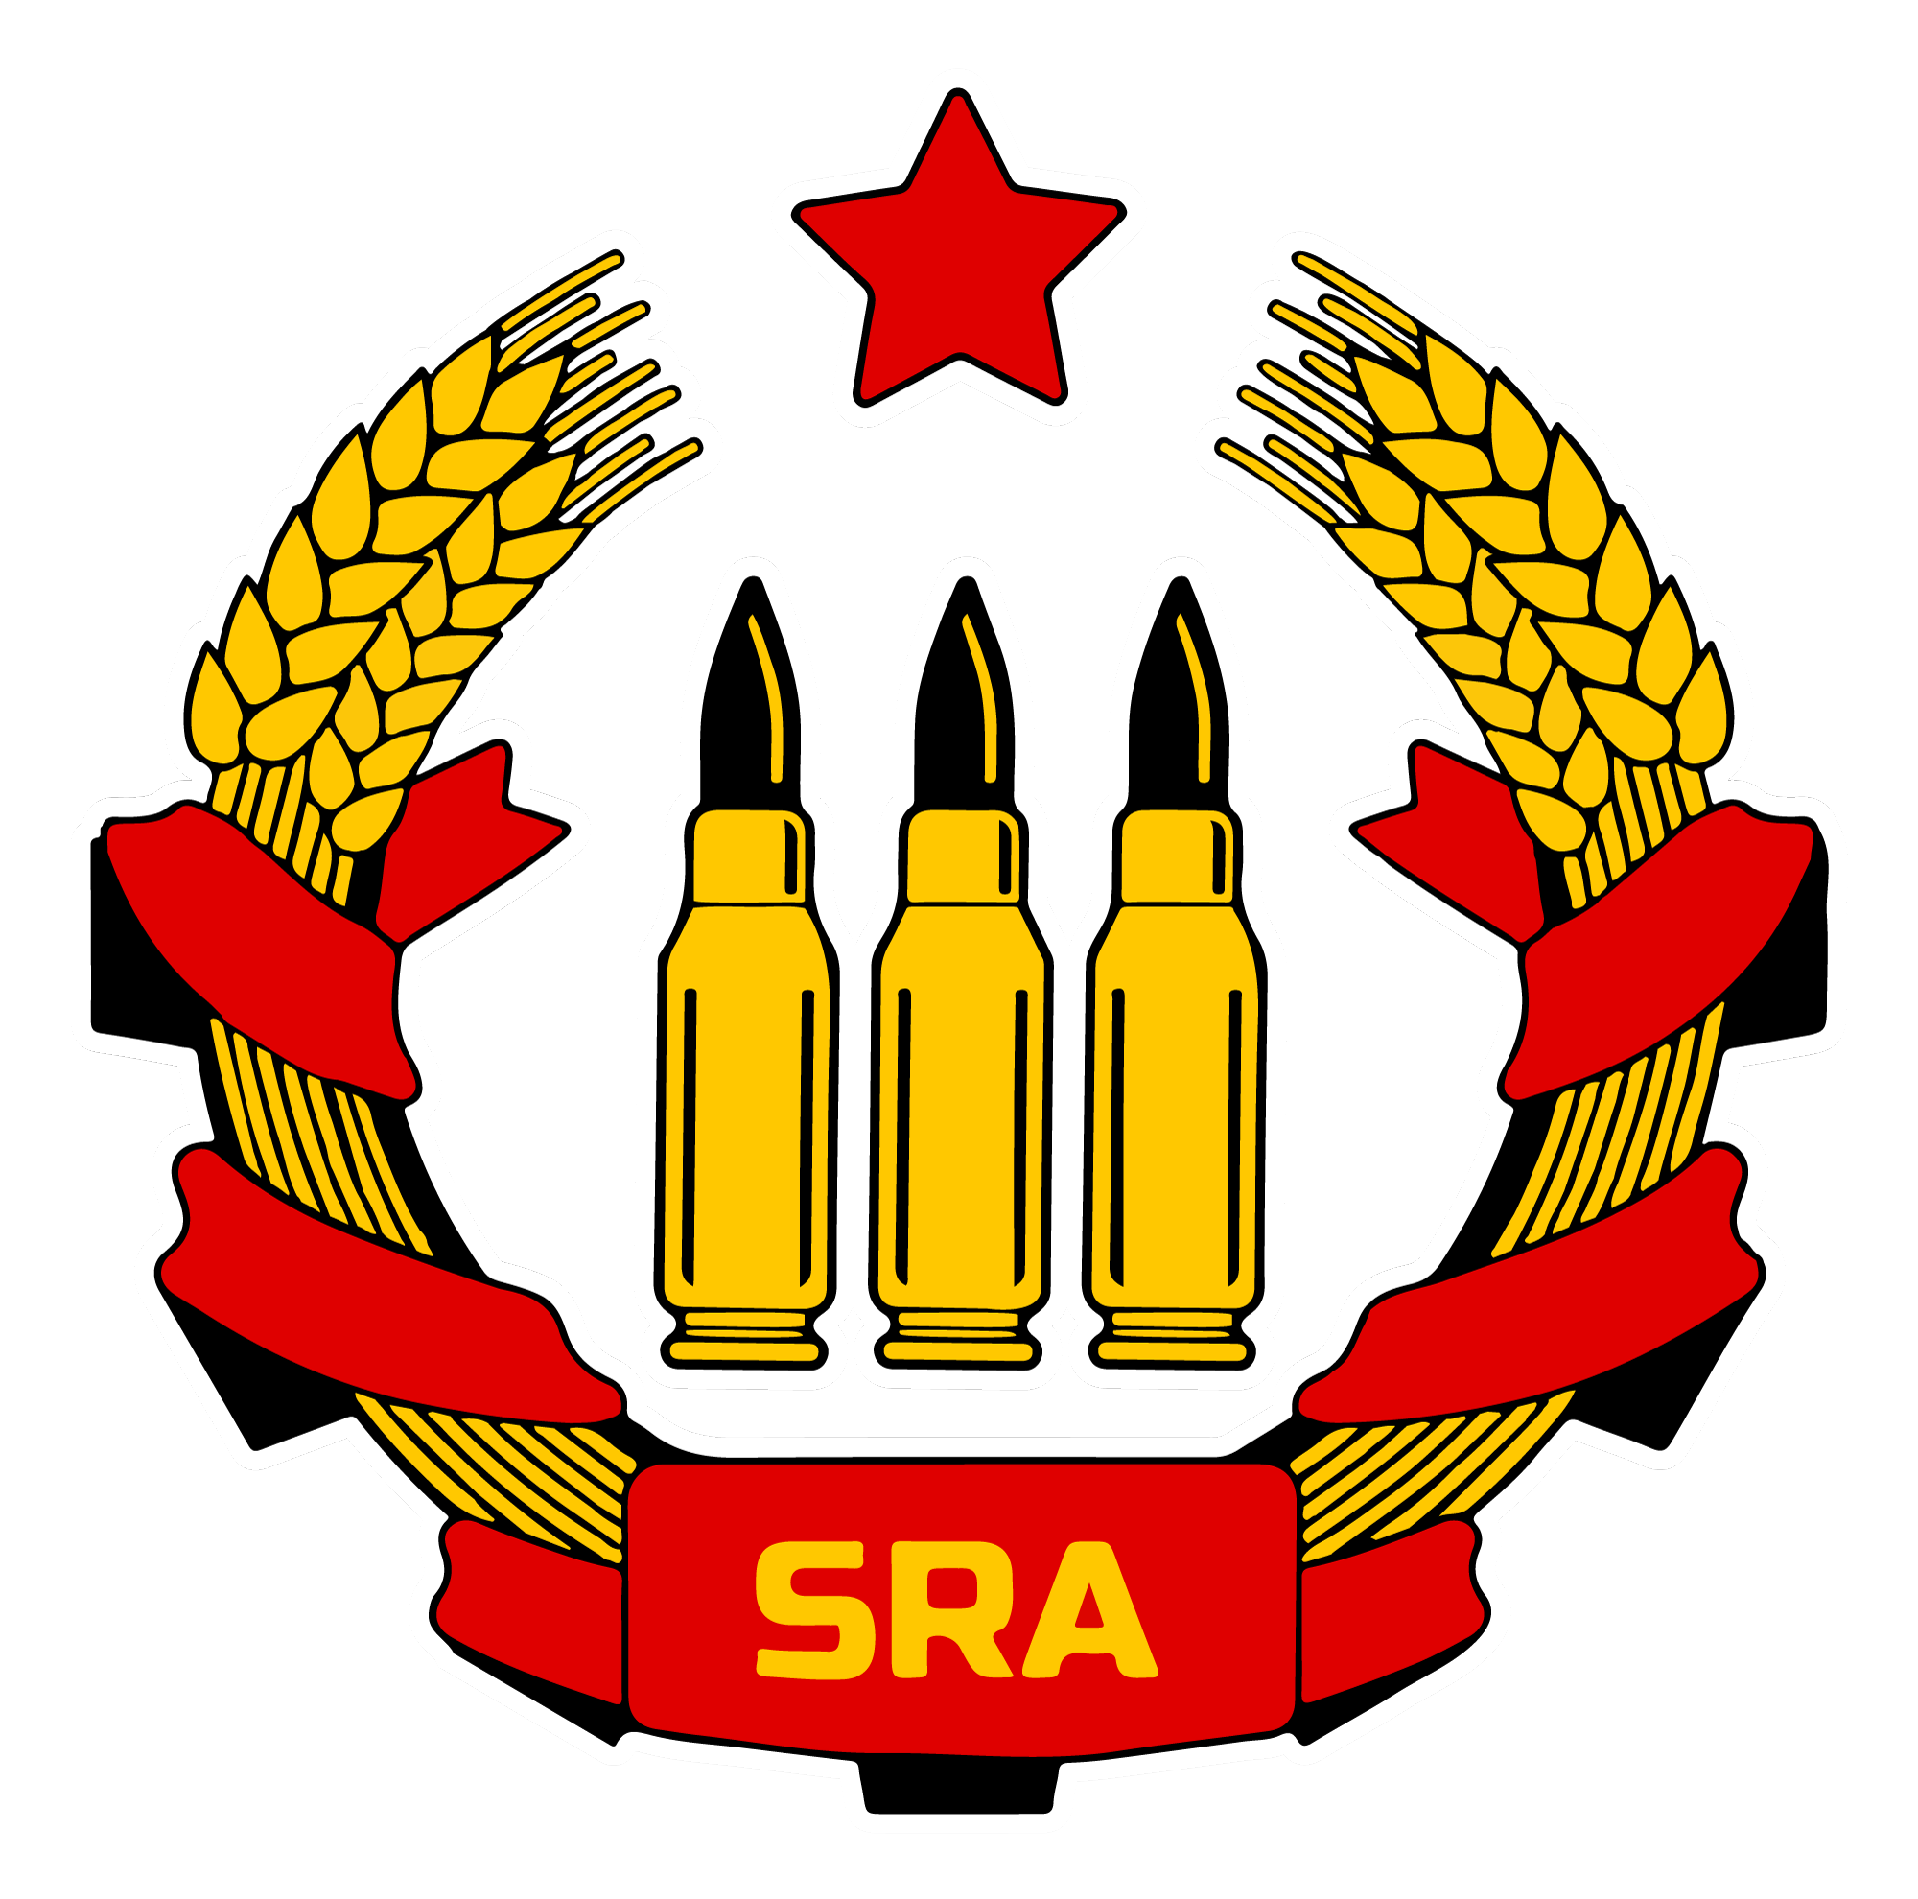
Socialist Rifle Association
FSF101 - Intro to Pistols

Slide 2
Part 1
Universal Safety Rules
What IS a Revolver?
What IS a Semi-Automatic?
What IS a Striker-Fired Pistol?
Defining a Pistol ‘Action’
The Magazine
Clearing a revolver
Clearing a semi-automatic
Part 2
First Time Buyers Tips
Pros / Cons
Ammunition components
Understanding calibers
Ammunition care and storage
Common Malfunctions
COURSE OUTLINE

Slide 3
Disclaimer:
Laws governing Use of Force are complex and vary greatly from locale to locale. Always ensure that you are in compliance with any and all relevant laws; consult with a lawyer if you aren’t sure.
This course is for informational purposes only and does not constitute as legal advice, nor are the Instructors legal representatives.
This course does not fulfill the requirements for firearms training or for obtaining a license in any jurisdiction where a license is required.

Slide 4
Part 1 Section 1 - Firearm SAfety Fundamentals
Rule 1 - ALWAYS keep firearm pointed in a safe direction.
Rule 2 - Keep your finger straight and off the trigger until you NEED to fire.
Rule 3 - ALWAYS treat a firearm as if it is loaded. (Drop/Lock/Look)
Rule 4 - Understand the “Big Picture Theory”
MAJORITY of “accidental” firearm injuries / deaths result from NEGLIGENCE of following the 4 fundamental rules of firearm safety.
New Users - Get familiar and practice as much as able.
Experienced Users - Are you complacent? Do you ALWAYS practice proper safety? NEVER allow your comfort with experience become complacency.
Notes:
Big Picture Theory is “Always be aware of your surroundings / Always know your target, and what is around and beyond the target.”

Slide 5
Part 1 Section 1A - Additional Safety Tips
Be sure your gun is safe to operate
Know how to use your gun safely
Store guns & ammo so they are not accessible to unauthorized hands
Use ONLY the correct ammunition for your gun
Caliber and +P / +P+ rounds
Always thoroughly wash your hands after handling or firing your gun; lead contamination has a multitude of negative health effects
Wear eye & ear protection as appropriate
NEVER use alcohol or drugs before or while armed
Obtain additional firearms training
Follow manufacturer’s recommendations
Inspect & maintain your gun & additional gear

Slide 6
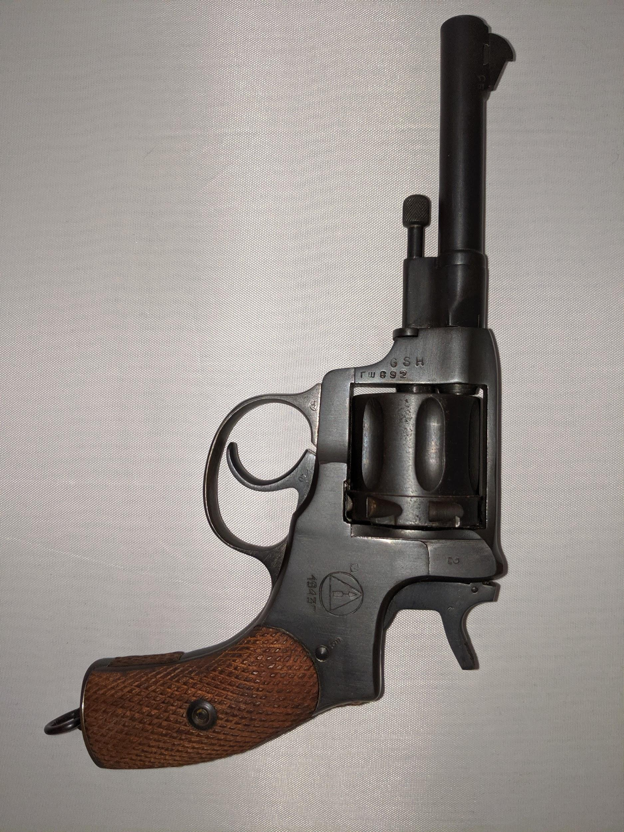
Part 1 Section 3 - What IS a Revolver?
Front Sight
Barrel
Cylinder
Hammer
Frame
Muzzle
Ejector Rod
(Identification of major parts of a Revolver)
*Nagant M1985 Revolver Pictured
Type: Double Action
Caliber:7.62x38R
Barrel: 4.5 In
Effective Range: 50 Yds
Trigger Guard
Trigger
Grip

Slide 7
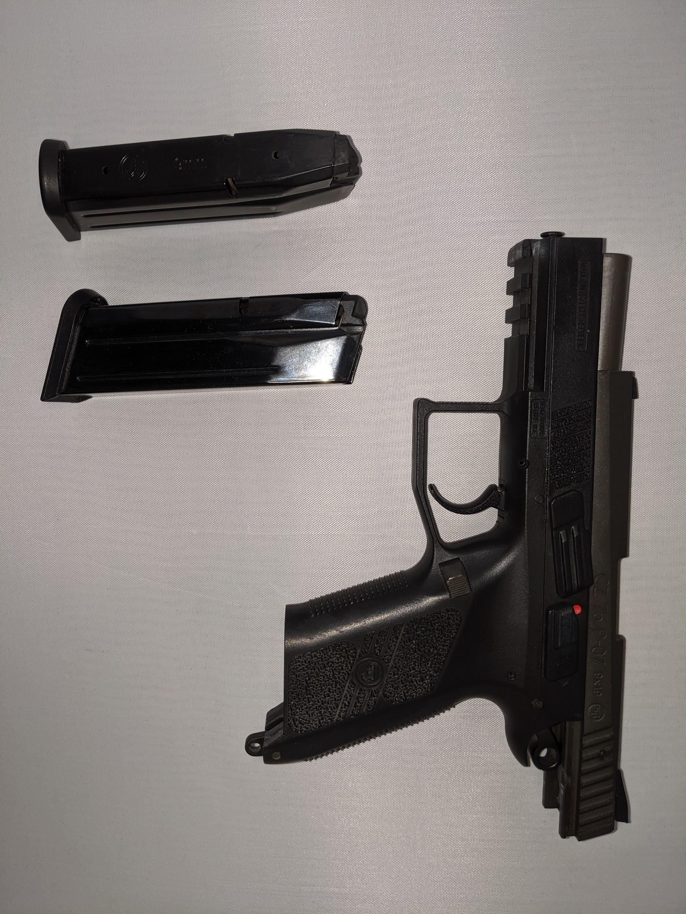
Part 1 Section 4 - What IS a Semi-Automatic?
Barrel
Safety
Slide
Muzzle
Magazine Release
Rail
Frame
Trigger
(Identification of major parts of Semi-Automatic)
*CZ P-09 Duty Pictured
Type: Single/Double Action
Caliber:9x19
Barrel: 4.54 In
Effective Range: 50 Yds
Magazine

Slide 8
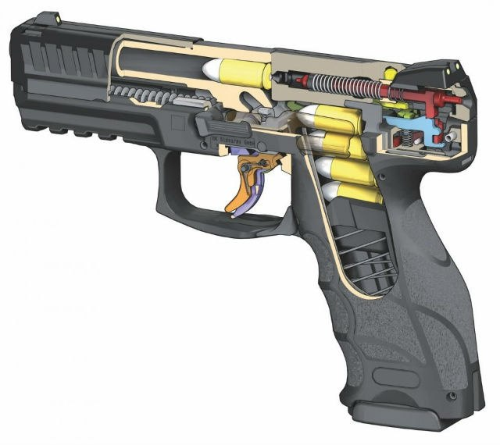
Part 1 Section 5 - What IS a Striker FIred Pistol?
Cocking Indicator
Striker
Cutaway of a Striker Fired pistol.
Trigger
Notes:
The “striker” is held back by the internal system in this pistol. Once the trigger is pulled, the sear releases the spring loaded striker and it strikes the primer. Note the gap between the cartridge and the striker pin, whereas in a traditional hammer/sear firearm the pin would be practically pressed up against the primer. (This is where hammerfollow issues come from; when powder, dirt, etc get in behind the firing pin and lodge it slightly forward, the cycle process can unintentionally set off the cartridge when chambering a new round.)

Slide 9
Part 1 Section 6 - Defining a Pistol’s Action
Handgun / Pistol are general and interchangeable terms.
There are 5 common types of handgun actions, which will be covered below.
Single Action Only
Single action is as stated; does one thing; release the hammer to fire the gun.
Hammer has to be cocked back first time before trigger is pulled to fire the cartridge, which is accomplished during the action of racking the slide.
Will not fire when the trigger is pulled unless hammer has been cocked back. External safety is often a prominent feature.
Double Action
Double Action triggers do two actions; cock the hammer while pulling the trigger, and then release the hammer once fully pressed.
Can be fired as a single-action if the hammer is cocked prior, which also greatly reduces the force required to pull the trigger. Most revolvers will technically fall under this category.

Slide 10
Part 1 Section 6 - Defining a Pistol’s Action (Cont.)
Double Action Only
Same concept as Double Action, only the hammer cannot be manipulated to engage a single-action firing mode. Hammer does not stay cocked after trigger pull, but completely resets each time.
These are also called “shrouded hammer” firearms in the case of revolvers.
Single/Double Action
Majority of semi-automatic pistols. Round can be chambered, and fired with the hammer cocked or decocked. Once fired, the slide will cock the hammer during its cycle and will be ready to fire again in single-action mode. Decocking the hammer after disengaging is a higher need in terms of safety for this style firearm. Decocking the firearm can be dangerous if done improperly.
Striker-Fired Action
Striker-fired guns are sometimes mistaken for Double-Action Only firearms, but the firing system is fundamentally different from the familiar hammer/sear system in other pistols.
Ultimately they are very popular for everyday carry due to no external hammer, no external safety (on most) and a single weight trigger pull every time.

Slide 11
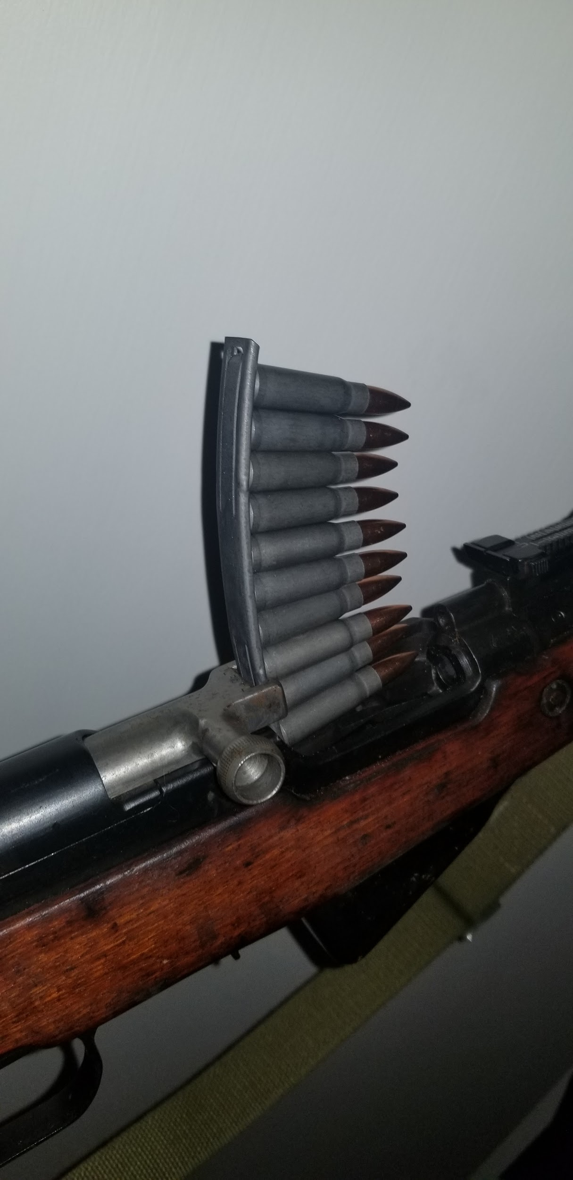
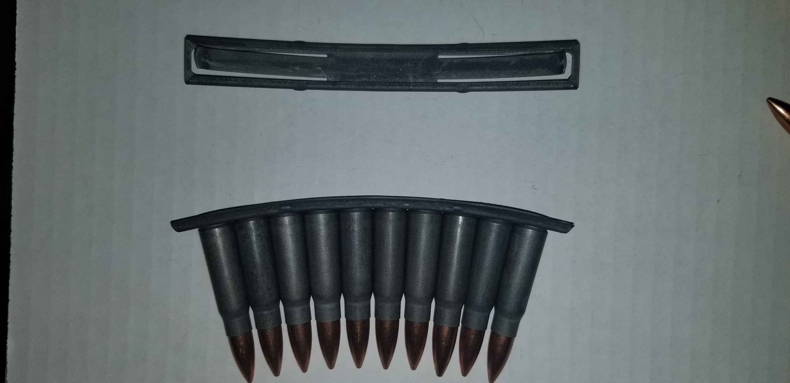
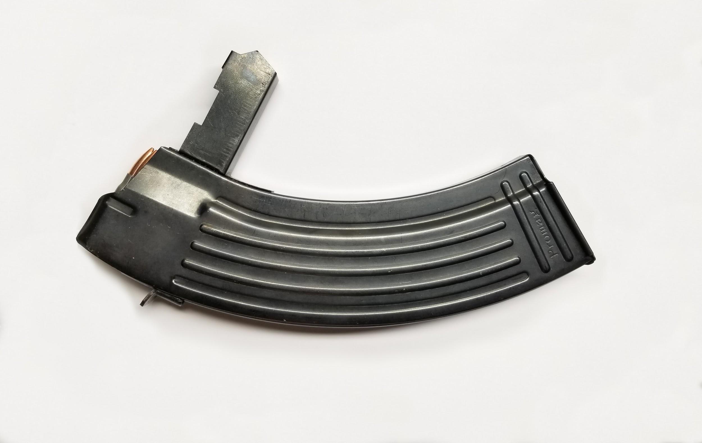
Part 1 Section 6 - What IS a MaGAZINE?
“Clip”
“Magazine”
Notes:
The terminology is interchangeable for the majority of people. Generally folks will know what you are talking about when referencing one or the other.
Clips - Stamped metal bracket that holds ammunition for rifles that do not have a detachable magazine.
Magazine - Spring loaded container that holds rounds and the cycle process feeds rounds into the chamber of the firearm.

Slide 12
Part 1 Section 7 - CLearing a Revolver
Step 1 - Hit the cylinder release or open the gate to access the cylinder.
Step 2 - Use the plunger to push out the cartridges or use the attached rod to push the cartridges back through the gate, tipping the barrel up slightly to assist in ejection.
Step 3 - Visually confirm cylinder is empty.
Do not do it from the barrel end of the gun. Do it from the same direction the ammo was released from.
Open cylinders are easy to verify, visually confirm all holes are clear.
Gated cylinders must be visually checked one at a time; rotate the cylinder each time to verify all holes are cleared.
Step 4 - Leave cylinder outside the frame / leave gate open until ready to reload or store.
* Never assume the revolver is safe because you believe you fired all the cartridges; always unload the revolver prior to proper storage.

Slide 13
Part 1 Section 8 - Clearing a Semi-Automatic
Called the “Drop, Lock & Look” method.
Step 1 - Press magazine release to free the magazine from the firearm.
*Keep your non-firing hand under the magazine well, as the magazine may fall free and can be damaged if it hits the ground.
Step 2 - Manually lock the slide to the rear.
*This should eject the round if located in the chamber. It also allows for visual confirmation of the chamber itself. Never grab the slide forward of the ejection port as it may be extremely hot. Use the serrations on the rear of the slide. Grasp the serrations firmly, and pull all the way back. Press upward on the slide release while allowing the slide to slowly move forward to engage the release and lock the slide open.
**DO NOT stick a finger into the open chamber to manually check if empty; you are prone to injury if the slide releases.
Step 3 - Visually check the chamber for brass / blockage.
Do not do it from the barrel end of the gun.
Keep slide locked back while handling / remove slide for cleaning, etc.

Slide 14
Part 2 Section 1 - FIrst TIme Buyers Tips
There may be times when you find yourself coming in contact with a firearm in a non-threatening manner, and safety should be of the utmost importance.
First thing to understand is that firearms are an ingrained part of the US culture; They aren’t going to magically disappear anytime soon.
Many households have multiple firearms, stored properly or not.
At minimum being familiar with what it is and how it works, even if you never plan on buying/using a firearm for self-defense should be a minimum.

Slide 15
Part 2 Section 1 - FIrst TIme Buyers Tips (COnt.)
When it comes to a forceful encounter, generally the only way to counter that action is by an equal force.
When faced with a threat of deadly force, a firearm does one better than most means of self defense; it can keep the attacker at a safe distance. With that distance, it increases your chances of survival and can be a deterrent for that attacker to close the gap.
When looking to purchase, you want to find a firearm that fits YOU;
There are many factors to consider, and the advice given by online sources, retail outlets, and even your friends may not apply to your situation.
Many shooting ranges offer rental guns and will be happy to help find the best gun for you and your needs.
Guns are expensive, potentially deadly, and a huge responsibility. Choosing right the first time will greatly increase your enjoyment and safety.

Slide 16
Part 2 Section 1 - FIrst TIme Buyers Tips (COnt.)
There are plenty of considerations to look at even before you think of purchasing your first firearm;
Can you also afford peripherals? A quality holster and gun safe should not be considered optional.
Carrying a gun in a bag/backpack/purse or pocket is extremely dangerous because foreign objects can compress the trigger; always use a holster with positive retention.
If you are planning to carry for self or home defense, you should consider purchasing liability insurance and be absolutely sure you are prepared for the mental and emotional implications of firing a gun with deadly intent.
Verify that you have all required licenses for your state/town, and that there are no prohibited persons in your home;
Check with a lawyer if you aren’t sure.
For first time buyers, it is generally better to buy a new gun;
Used firearms can vary wildly in quality and maintenance.
If you do decide to buy used, probably take your gun to a qualified gunsmith before firing it for the first time.

Slide 17
Part 2 Section 2 - Pros and COns
Pros:
Reliability - Less parts + Less issues. No manual clearing of a jam, simply pull trigger.
Straightforward - Make sure it’s loaded, aim, pull trigger.
Concealable - Shrouded revolvers make good “pocket pistols”. Small profile, small barrel, minimized hammer, etc.
Cons:
No manual safety - Can be a concern for some folks.
Capacity - 5-8 rounds average. Reloading can take time.
Heavy Trigger - Pull can be almost 3x that of a semi-automatic. Manual dexterity issues will have negative impact in ability.
Section 2A - Pros/Cons of a Revolver

Slide 18
Part 2 Section 2 - Pros and COns
Pros:
Capacity - 2x/3x that of Revolvers. Quick reload times.
Variety - Multiple sizes / calibers to choose from, even from a single brand.
Customization - Triggers, grips, sights, rails, etc. Can be made to fit your needs
Cons:
Complicated - Many parts = potential for more issues. Manual clearing of jams/misfires/etc.
Slide Resistance - Manual dexterity can be an issue when a heavy slide needs to be racked, especially with minimal surface area to grab.
Finicky - Slide has to make a complete cycle to chamber rounds properly; lower energy rounds may not provide enough force to cycle properly.
Section 2B - Pros/Cons of a Semi-Automatic

Slide 19
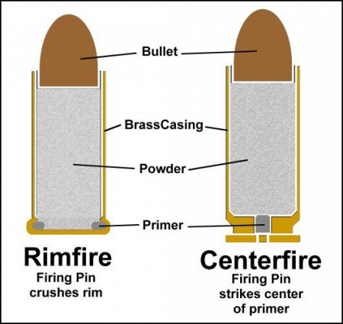
Part 2 Section 3 - Ammunition Components

Slide 20
Part 2 Section 4 - Understanding Cartridges
Caliber is the diameter of the bullet (or internal barrel diameter depending on who you talk to, but means the same thing).
It can be expressed in Metric (9mm) or by English Standard (.308)
Most of the time it will depend on where exactly the cartridge was developed. (US vs Europe)
Calibers aren’t always exacting measurements
.30-06, .308 and 300 Magnum are all .30 caliber rounds. (all rounds are .308inch in diameter.) But they are non-compatible with each other. The other numbers are for how many grains (weight) the bullet is, when it was made, case length, etc.

Slide 21
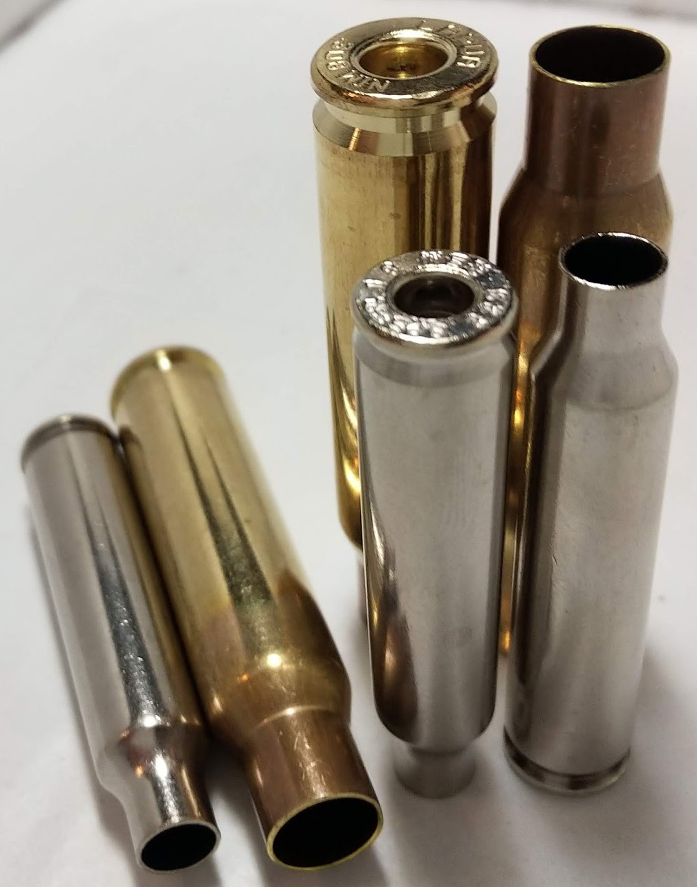
Part 2 Section 4 - Understanding Cartridges
Made of Brass, Steel, Aluminum, Plastic (Shotgun rounds)
Contains all other parts of the cartridge.
Sized to fit perfectly in the specific firearms chamber
Component:
Casing

Slide 22
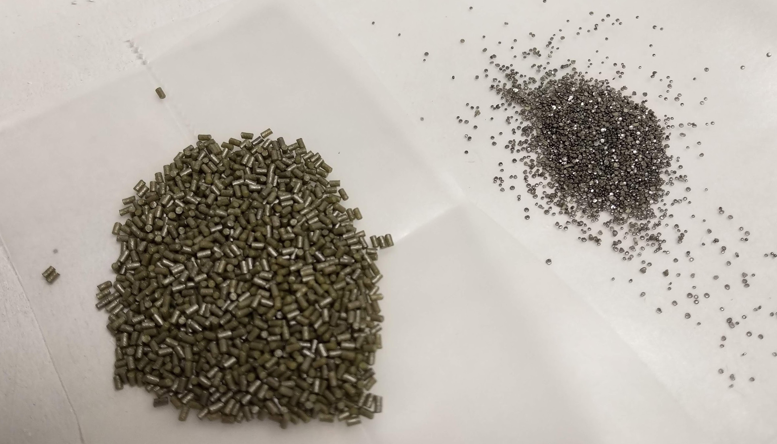
Part 2 Section 4 - Understanding Cartridges
Generally made of Nitrocellulose, Centralites, Tin compounds and Potassium derivative. They can be in the shape of shavings, balls, cylinders, strips, etc. The shape determines the composition. Usually coated in Graphite to prevent static discharge setting off the compounds.
Component:
Powder

Slide 23
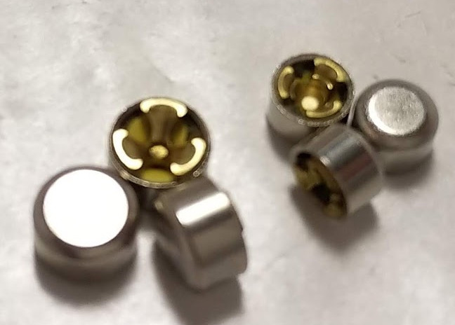
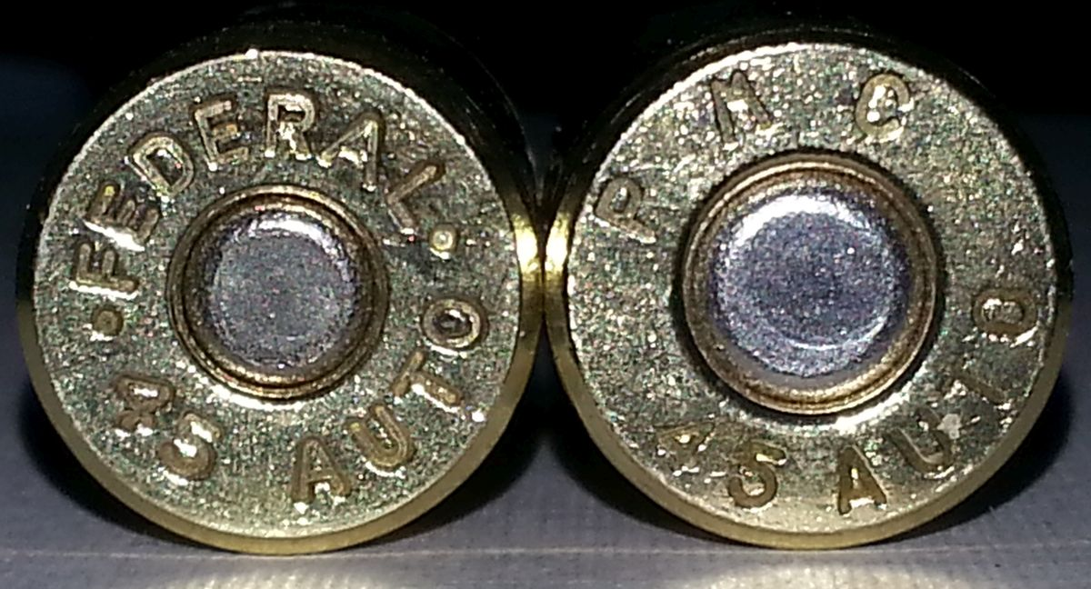
Part 2 Section 4 - Understanding Cartridges
Centerfire and Rimfire cartridges are fundamentally similar, but how the priming charge is applied is different.
Rimfire cartridges (primarily .22 variety) the priming charge is coating the entire inner bottom of the casing, and the case is thin enough for a hammer to crimp the case upon striking, setting off the charge.
Centerfire cartridges have the priming compound in a small cap placed in the center of the casing. This allows for a more reliable charge. This also allows for a thicker casing to make more efficient cartridges.
Component:
Primer

Slide 24
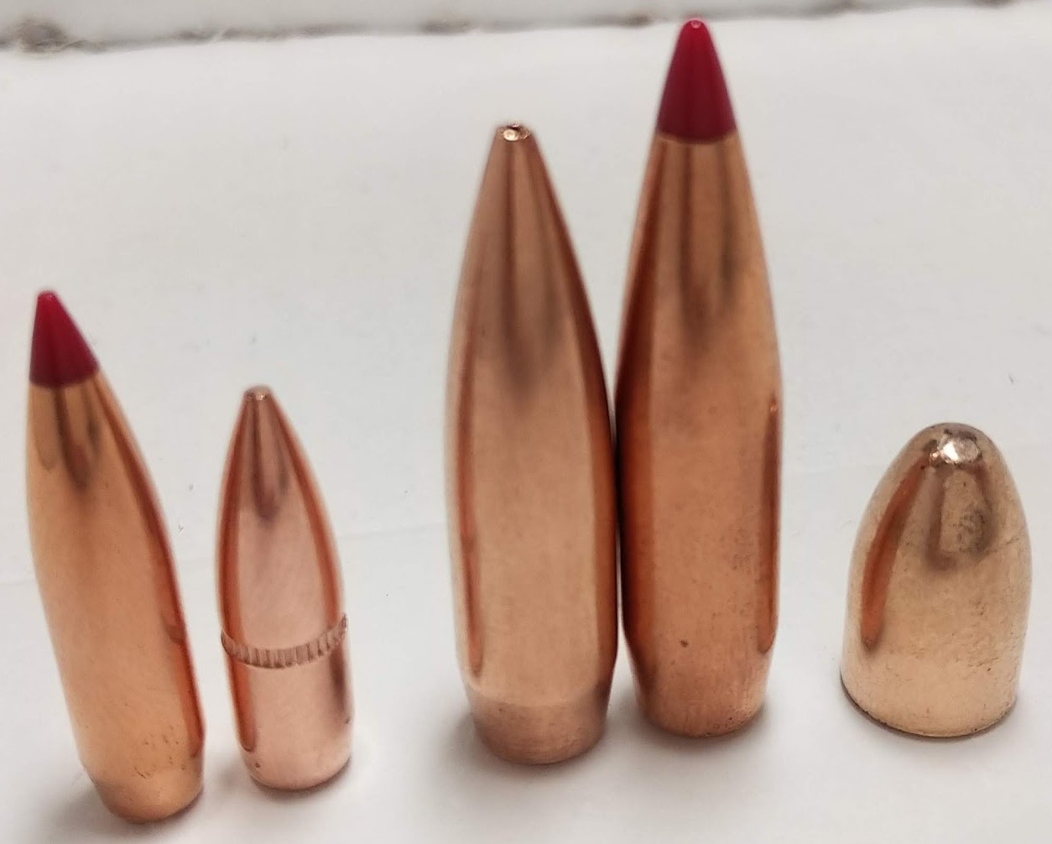
Part 2 Section 4 - Understanding Cartridges
Projectile that leaves the gun by the produced kinetic energy from the discharge of the firing compound.
Generally made of lead, steel or copper. Can be made of polymer, rubber, or other various materials.
Component:
Bullet

Slide 25
Part 2 Section 5 - Ammo Storage and care
Always store in factory container; This ensures quick and easy identification of the cartridge. Also provides convenient storage.
Do not expose to water or solvent/cleaner
Rounds are not completely air-tight and moisture can indeed penetrate and ruin the firing powder, causing a dud round or deteriorating the charge enough to produce an incomplete discharge.
Do not rely completely on rounds that have been “sealed” to such elements. They are reliable, but not 100% efficient in that regard
Store out of reach of children and unauthorized persons.
Ammo does not require a firearm to be dangerous. Do not give people the opportunity to find work-arounds.
Storing your ammunition with your firearms is also not ideal in case of a break in or if temperatures fluctuate or increase to high levels of heat, which may eventually lead to discharge of the cartridge.
Long-Term storage should include;
Keep ammunition dry
Protect ammunition from theft, unauthorized use/discharge
Maintain low humidity levels
Stable temperatures between 50-70 degrees Fahrenheit

Slide 26
Part 2 Section 6 - Common Malfunctions
Dud Rounds
No discharge from the round
What to do: Keep the gun pointed downrange with your finger off the trigger for 30 seconds, in case it’s actually a Delayed Discharge. After 30 seconds, clear the gun and place it on the firing line, pointed downrange with the slide locked open, then put the dud round in the range’s hot/live box, which should be clearly marked.
Incomplete Discharge (Squib loads)
Partial discharge; Round may not leave barrel of firearm, causing blockage and great risk if fired again.
What to do: Stop firing! Clear the gun and step away from the firing line. Have the gun inspected for damage by a qualified gunsmith. In a worst case, you may need to replace the barrel.
Delayed Discharge
Firing compound has a delayed reaction in its cycle. Perceived delay (up to a few seconds) before proper discharge. More common in older, surplus ammunitions that have seen inadequate storage.
What to do: Keep the gun pointed downrange with your finger off the trigger for 30 seconds, or until the round goes off, same as a dud round, except it will discharge at some point.
Failure to Eject
Spent casing does not leave firearm completely, or does not leave the chamber properly.
What to do: Remove the magazine from the gun, then clear it as you normally would.

Slide 27
Part 2 Section 6 - Common Malfunctions (Cont.)
Failure to Feed
Round does not leave magazine properly and does not chamber properly.
What to do: Clear the gun and place it on the firing line, pointed downrange with the slide locked open, then put the failed round in the range’s hot/live box, which should be clearly marked. Ask the RSO where it is if you can’t find it, or if you cannot get the gun cleared, as it can be locked up by this type of malfunction.
The round may have had the bullet pushed too far back into the case by the failed feed, which could be dangerous.
If this happens more than once with a particular box or brand of ammo, it may be incompatible with your gun and you should avoid it in the future.
Hammer-follow (Slamfire)
Firing mechanism has an issue that prevents it from working as intended. Cartridge is fired as the reloading cycle is completing after first round has been fired. Extremely dangerous, and can be considered “fully automatic” fire, even if your firearm isn’t technically equipped to do so.
Dirt, fouling, grease, etc. has gotten in around/behind the firing pin, holding it in an extended position and allowing it to strike the primer as the cartridge

Slide 28
YOu have successfully completed INtro to Pistols FSF101.
Questions?

Slide 29

-= CONGRATULATIONS =-
This document certifies and is hereby awarded to
CLICK TO ADD NAME
__________________________________________________________
For successfully completing the Socialist Rifle Association FSF101 - Intro To Pistols Course
taught by a certified Socialist Rifle Association Instructor
Instructor Name
________________________
Date of Completion
___________________
*This is not a State-approved course for Concealed Weapons qualification*
Notes:
Use this slide for printing certificates.

